Slide 1
Time Series Analysis & Forecasting Planning and Forecasting

Slide 2
Introduction
occurs when you make
scientific predictions based
on
historical time stamped data.
Build models through historical analysis
and usE them
to make observations and drive future strategic decision-making.

Slide 3
Applications
weather forecasting
climate forecasting
economic forecasting
healthcare forecasting
engineering forecasting
finance forecasting
retail forecasting
business forecasting
environmental studies forecasting
social studies forecasting

Slide 4
Categories - analytics
Descriptive Analytics, which use data aggregation and data mining to provide insight into the past and answer: “What has happened?”
Predictive Analytics, which use statistical models and forecasting techniques to understand the future and answer: “What could happen?”
Prescriptive Analytics, which use optimization and simulation algorithms to advise on possible outcomes and answer: “What should we do?”

Slide 5
Time series analysis vs. time series forecasting
Time series analysis is all about understanding the dataset; forecasting is all about predicting it.
Time series analysis comprises methods for analyzing time series data in order to extract meaningful statistics and other characteristics of the data.
Time series forecasting is the use of a model to predict future values based on previously observed values.

Slide 6
Three aspects of predictive modeling
Sample data
Learn a model
Making predictions

Slide 7
Few Aspects on type of time series
Is it stationary?
Is there a seasonality?
Is the target variable autocorrelated?

Slide 8
Overview
Why Forecast?
An Overview of forecasting techniques
Basic steps in a forecasting task

Slide 9
Why Forecast?
Necessary for implementation lead times. Considering
Uncontrollable external events: those that originate with the national economy, governments, customers.
Controllable internal events: such as marketing or manufacturing decisions within the firm.

Slide 10
Importance of forecasting
Good forecasting system
Influence profitability (dramatic influence), productivity and customer service.
Essential in eliminating waste (inventory shortages, missed due dates, plant shutdowns, lost sales, lost customers and missed strategic opportunities)
Best manufacturers, distributors, retailers and service organizations are distinguished by the excellence of forecasting system.

Slide 11
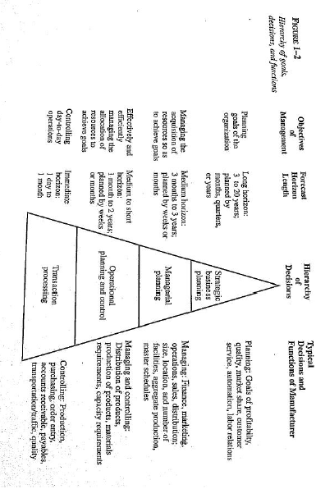
Management Decision Hierarchy
Forecasts drive all decisions

Slide 12
Role of Forecasting
In the following areas
Scheduling: Forecasts the level of demand
Determining resource requirements: Long term planning.
Acquiring resources: Lead time to acquire raw materials, etc.

Slide 13
What is a Forecast?
A probabilistic estimate of a future value or condition
Could include a Mean, Range and Probability estimate of that range.
Should be a point, range and a probability estimate
Eg. Expected sales next month for product X is 500 units with a 70% probability that the sales will be between 300 to 500 units”

Slide 14
An Overview of Forecasting Techniques
Quantitative:
Sufficient quantitative information is available.
It depends on judgment and accumulated knowledge.
Used to formulate Strategy, long-range plans, etc.

Slide 15
Quantitative data
An Overview of Forecasting Techniques
Time series:
Predicting the continuation of historical patterns (trends) such as the growth of sales or gross national product (GNP)
GNPt+1 = f(GNPt, GNPt-1, ….., error)

Slide 16
An Overview of Forecasting Techniques
Qualitative:
Little or no quantitative information is available, but sufficient qualitative knowledge exists.
Predicting the impact of giving doles by state governments thereby draining the treasury

Slide 17
When Can One Do Quantitative Forecasting?
Information about the past is available.
This information is available in the form of numerical data.
Assumption of continuity: It can be assumed that some aspects of the past pattern will continue into the future.
NB: Continuity assumption is also needed for qualitative forecasting

Slide 18
Why Forecasting Works?
Some aspects of the history do repeat themselves in a sense.

Slide 19
Types of forecasting methods
Decomposition ::Deconstruction of time series.
Moving-Average:: Tracking a single type of data
Exponential Smoothing:: Smooth-based model + exponential window function
Smooth-based :: Removal of anomalies for clear patterns

Slide 20

Modelling time series
Moving average
Exponential smoothing
ARIMA

Slide 21
Five steps in a forecasting task

Slide 22
Step 1: Problem definition.
To define the problem, get the following questions answered.
How the forecast will be used?
Who needs the forecast?
How the forecasting function fits within the organization?

Slide 23
To define the problem continued…
Also, one should set up meetings with everyone involved with this project, namely those:
Maintaining databases.
Collecting data.
Using data for future planning, etc.

Slide 24
Step 2: Gathering information
There are generally two kinds of information available.
statistical data (which is generally historic numerical data).
the accumulated judgment and expertise of key personnel.

Slide 25
Step 3: Preliminary exploratory analysis
It is to answer what do the data tell us?
Using graphic tools.
Descriptive statistics.

Slide 26
Another tool
Another useful tool is decomposition analysis. To answer:
Are there consistent patterns?
Is there a significant trend: is seasonality important?
Is there evidence of the presence of business cycles?

Slide 27
Preliminary analysis continued…
Are there any outliers? That needs to be commented upon by experts in the field.
How strong are the relationships among the variables available for analysis?

Slide 28
Step 4: Choosing and fitting models
Models to be fitted could be:
Exponential smoothing methods, regression models, box-Jenkins ARIMA models, non-linear models, regression with ARIMA errors, intervention models, transfer function models, multivariate ARMA models, and state space models.

Slide 29
Fitting models
Once a model has been judiciously selected, its parameters are estimated for model fitting purposes.
When forecasting is long-term, then a less formal approach is preferred.

Slide 30
Step 5: Using and evaluating a forecasting model
The fitted model's pros and cons are evaluated over time.
The performance of the model can only be properly evaluated after the data for the forecast period have become available.

Slide 31
Evaluating a forecasting model
There are many measures for evaluating both fitting and forecasting errors.

Slide 32
Using a forecasting model
If the forecast suggests a gloomy picture ahead, then management will do its best to try to avoid such scenario.
If the forecasts suggest a positive future, then management must try to use this forecast to enhance the likelihood of a favorable outcome

Slide 33

Predictive modeling: Few issues to be addressed
Volume of data available — more data is often more helpful, offering greater opportunity for exploratory data analysis, model testing and tuning, and model fidelity.
Required time horizon of predictions — shorter time horizons are often easier to predict — with higher confidence — than longer ones.
Forecast update frequency — Forecasts might need to be updated frequently over time or might need to be made once and remain static (updating forecasts as new information becomes available often results in more accurate predictions).
Forecast temporal frequency — Often forecasts can be made at lower or higher frequencies, which allows harnessing down sampling and up-sampling of data (this in turn can offer benefits while modeling).

Slide 34
Thank You

